Slide 1
CPA&GPA Calculator
C++
BY: Syahmi Hanis
Wan Nuraina Anisah
Shazwani Farzana

Slide 2
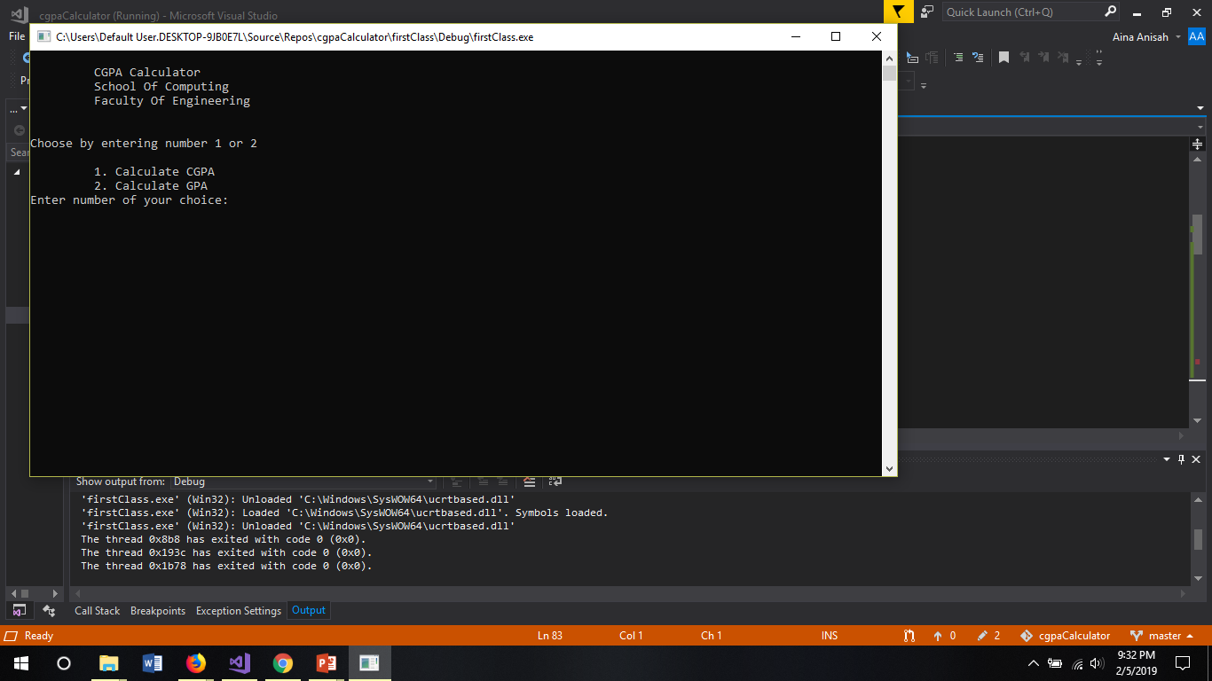
User requires to choose between 1 and 2 to calculate CGPA or calculate GPA. If student choose 1.

Slide 3

The students required to enter the total of semester they want to calculate.

Slide 4
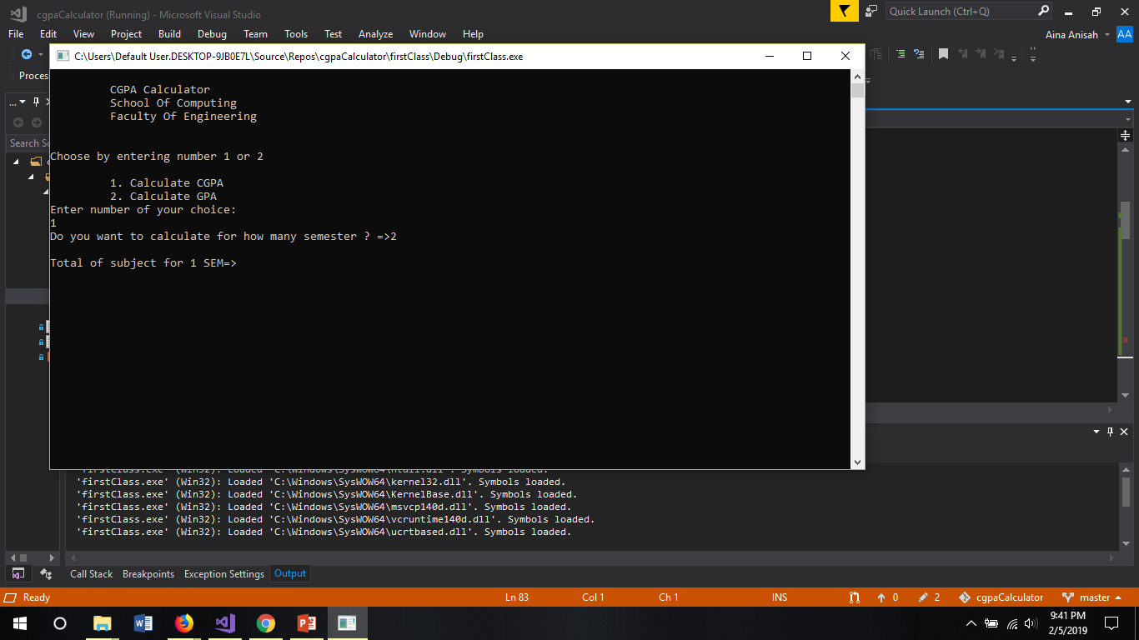
The students required to enter the number of subject for the first semester.

Slide 5
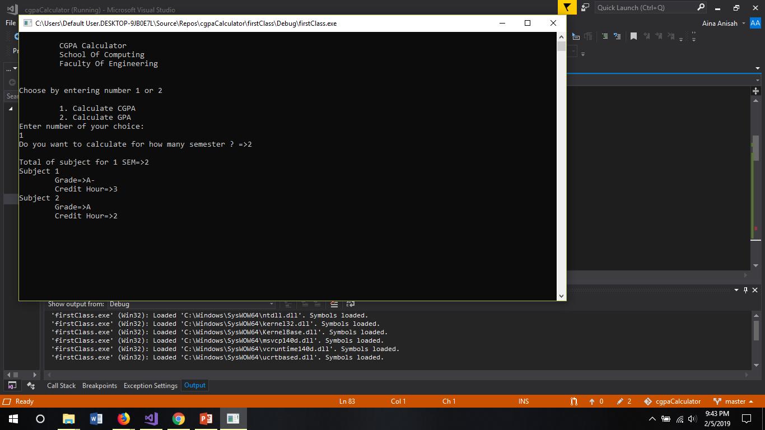
Enter the valid grade, such as A+,A-,B,C- and etc.
Then enter the credit hour.

Slide 6
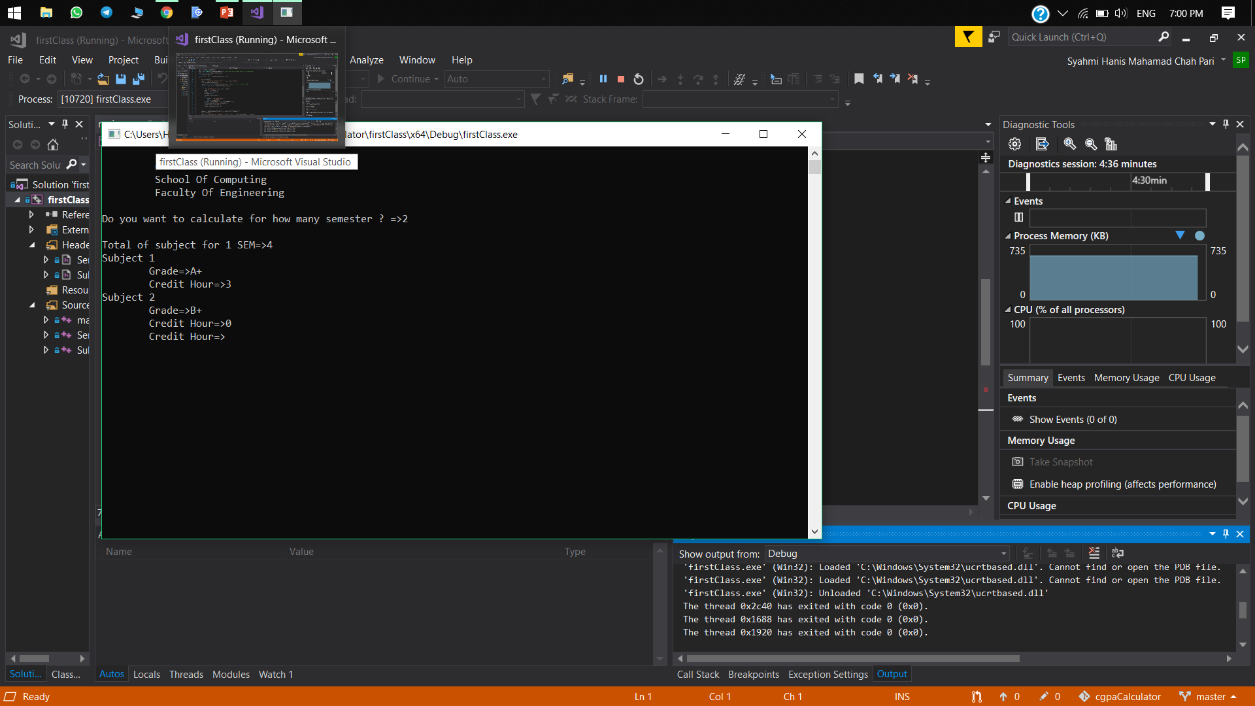
The program will only accept 1 until 4 credit hour. The program will not ask for valid credit hour until the user enter the correct required input.

Slide 7
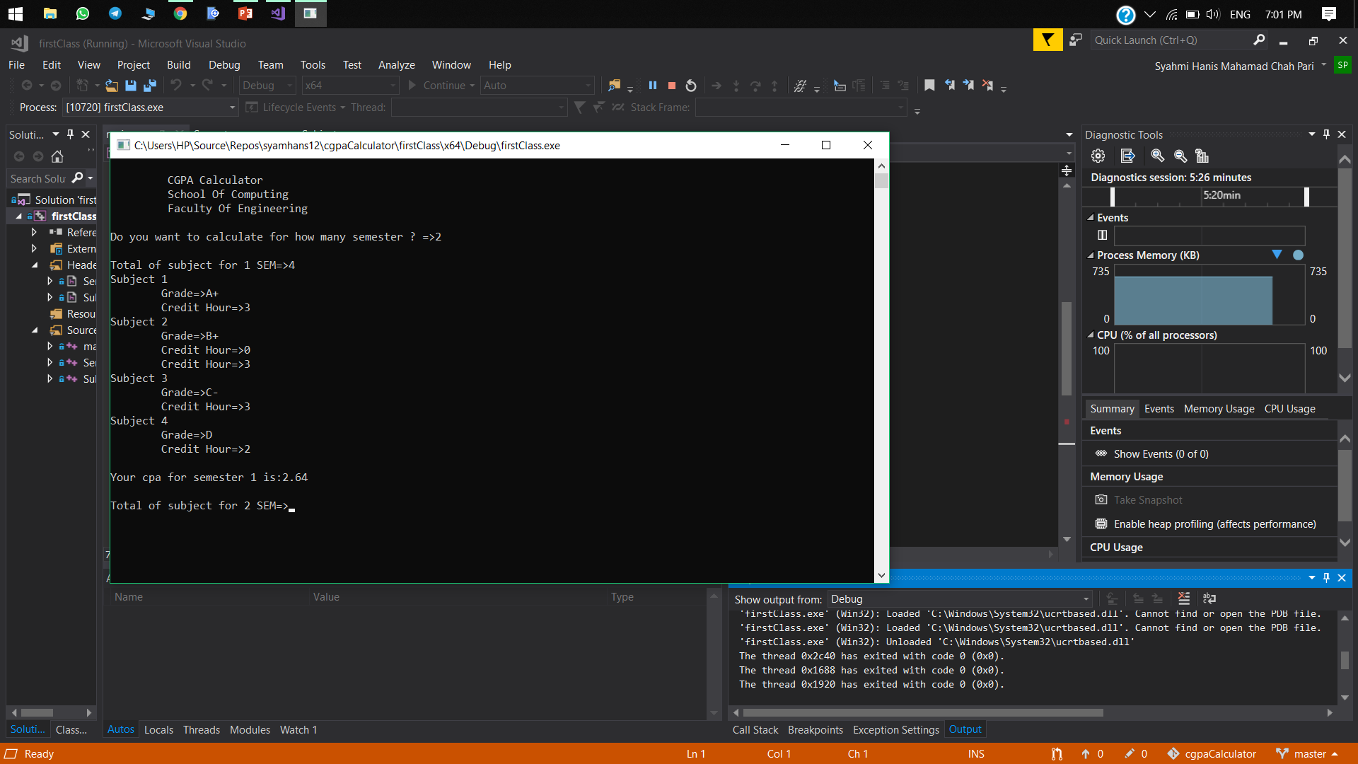
Users will get the CPA of their first semester.

Slide 8
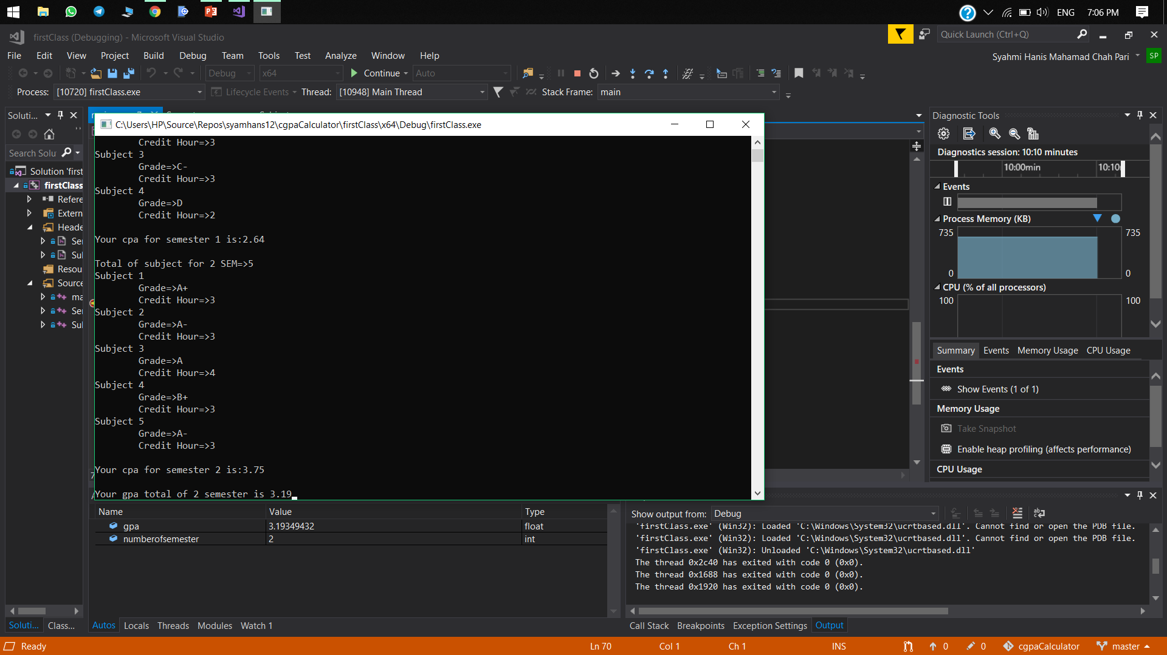
Repeat the same step as before for next semester. Once the program calculate all the CPA for the total of semester entered by the user, it will display the final CGPA.

Slide 9
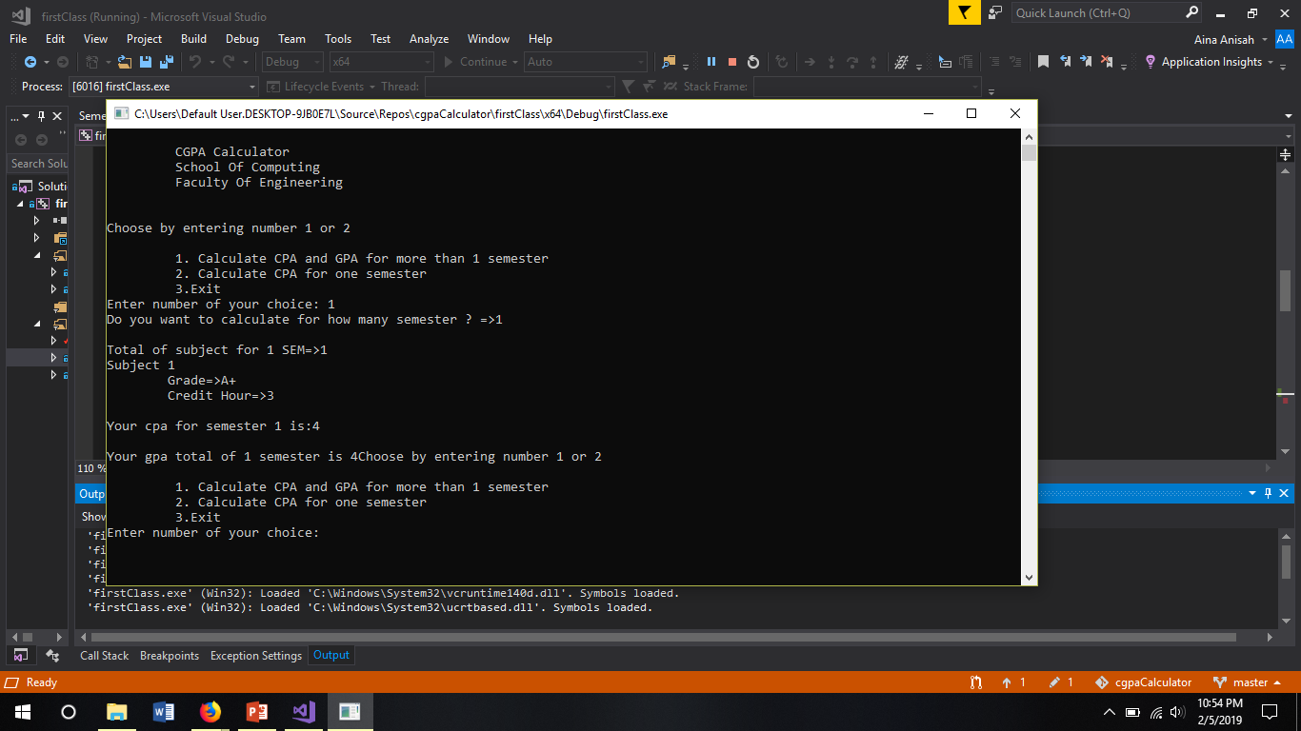
User requires to choose 1,2 or 3. If user choose 2.

Slide 10
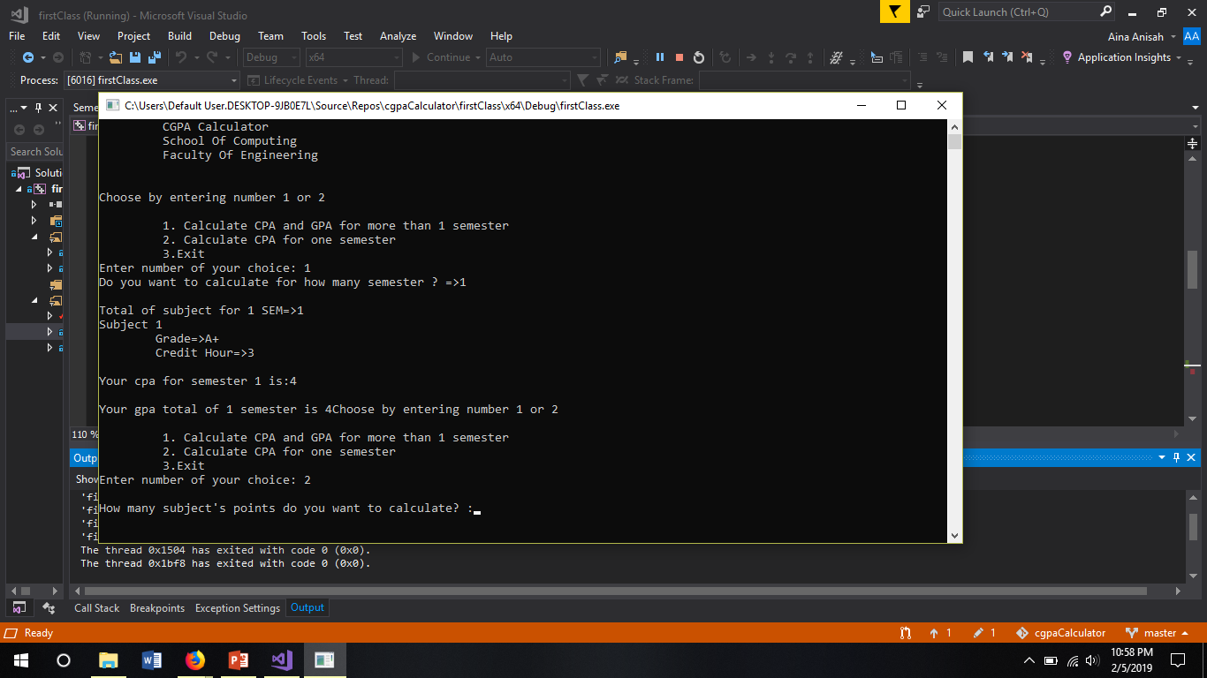
User needs to input how many subject taken.

Slide 11
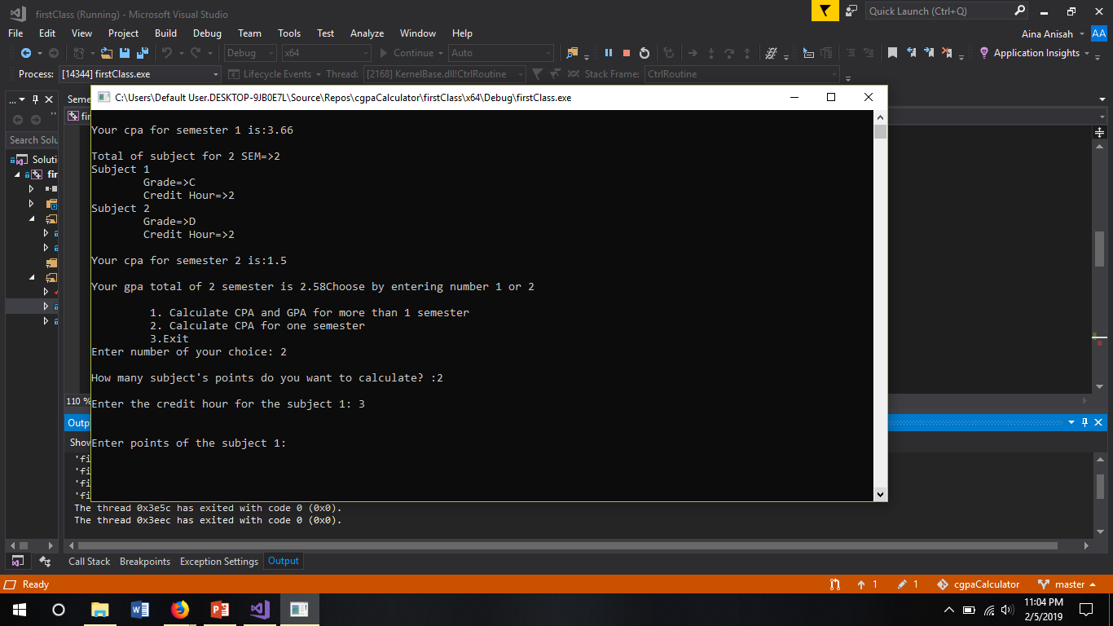
User needs to input credit hour for the subject between 1 to 4.

Slide 12
User needs to input grade points for the subject between 1.00 to 4.00.

Slide 13

User needs to input credit hour for the next subject. This is based on number of subject user input.

Slide 14
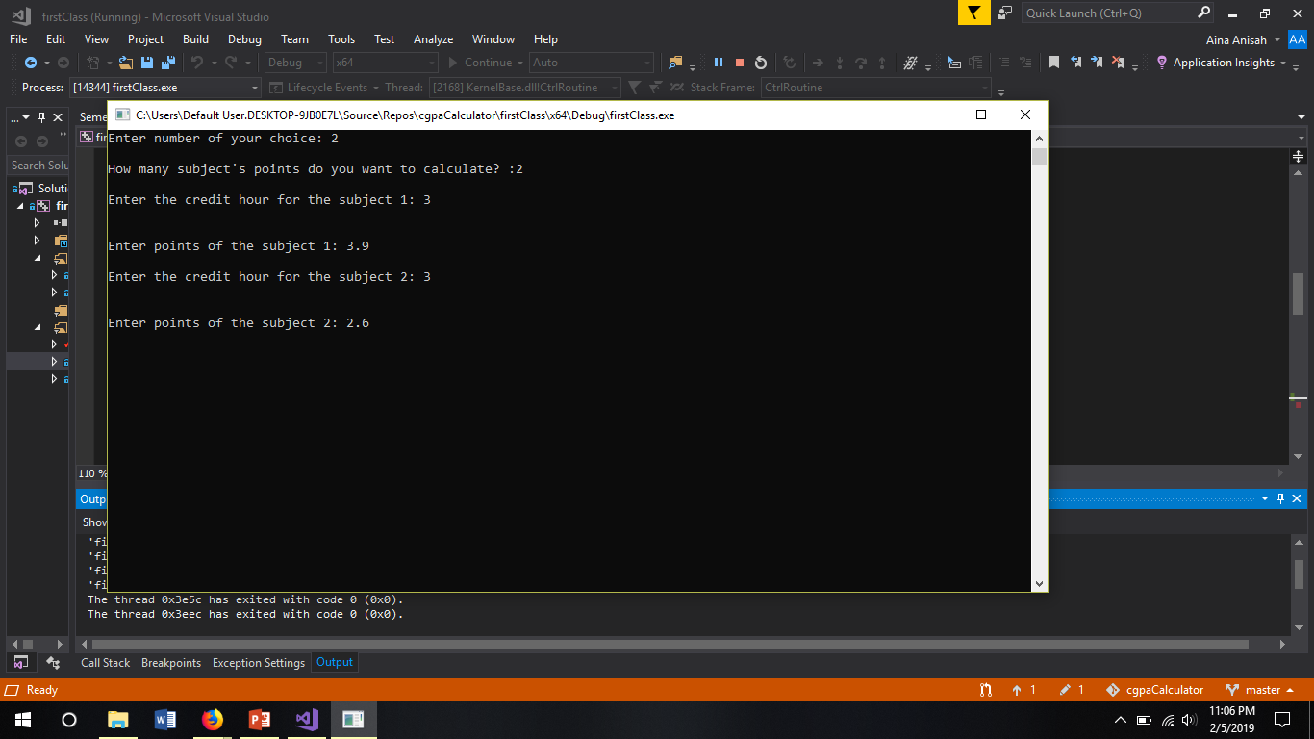
User needs to input grade points for the subject between 1.00 to 4.00.

Slide 15

Lastly, the total points will display. Next user can choose to continue or exit

